Slide 2

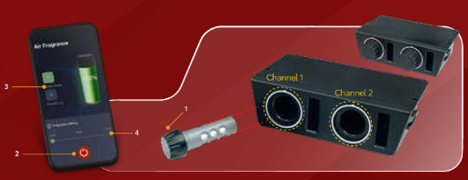
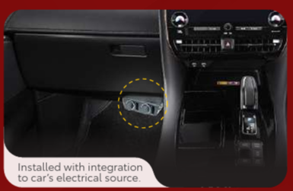
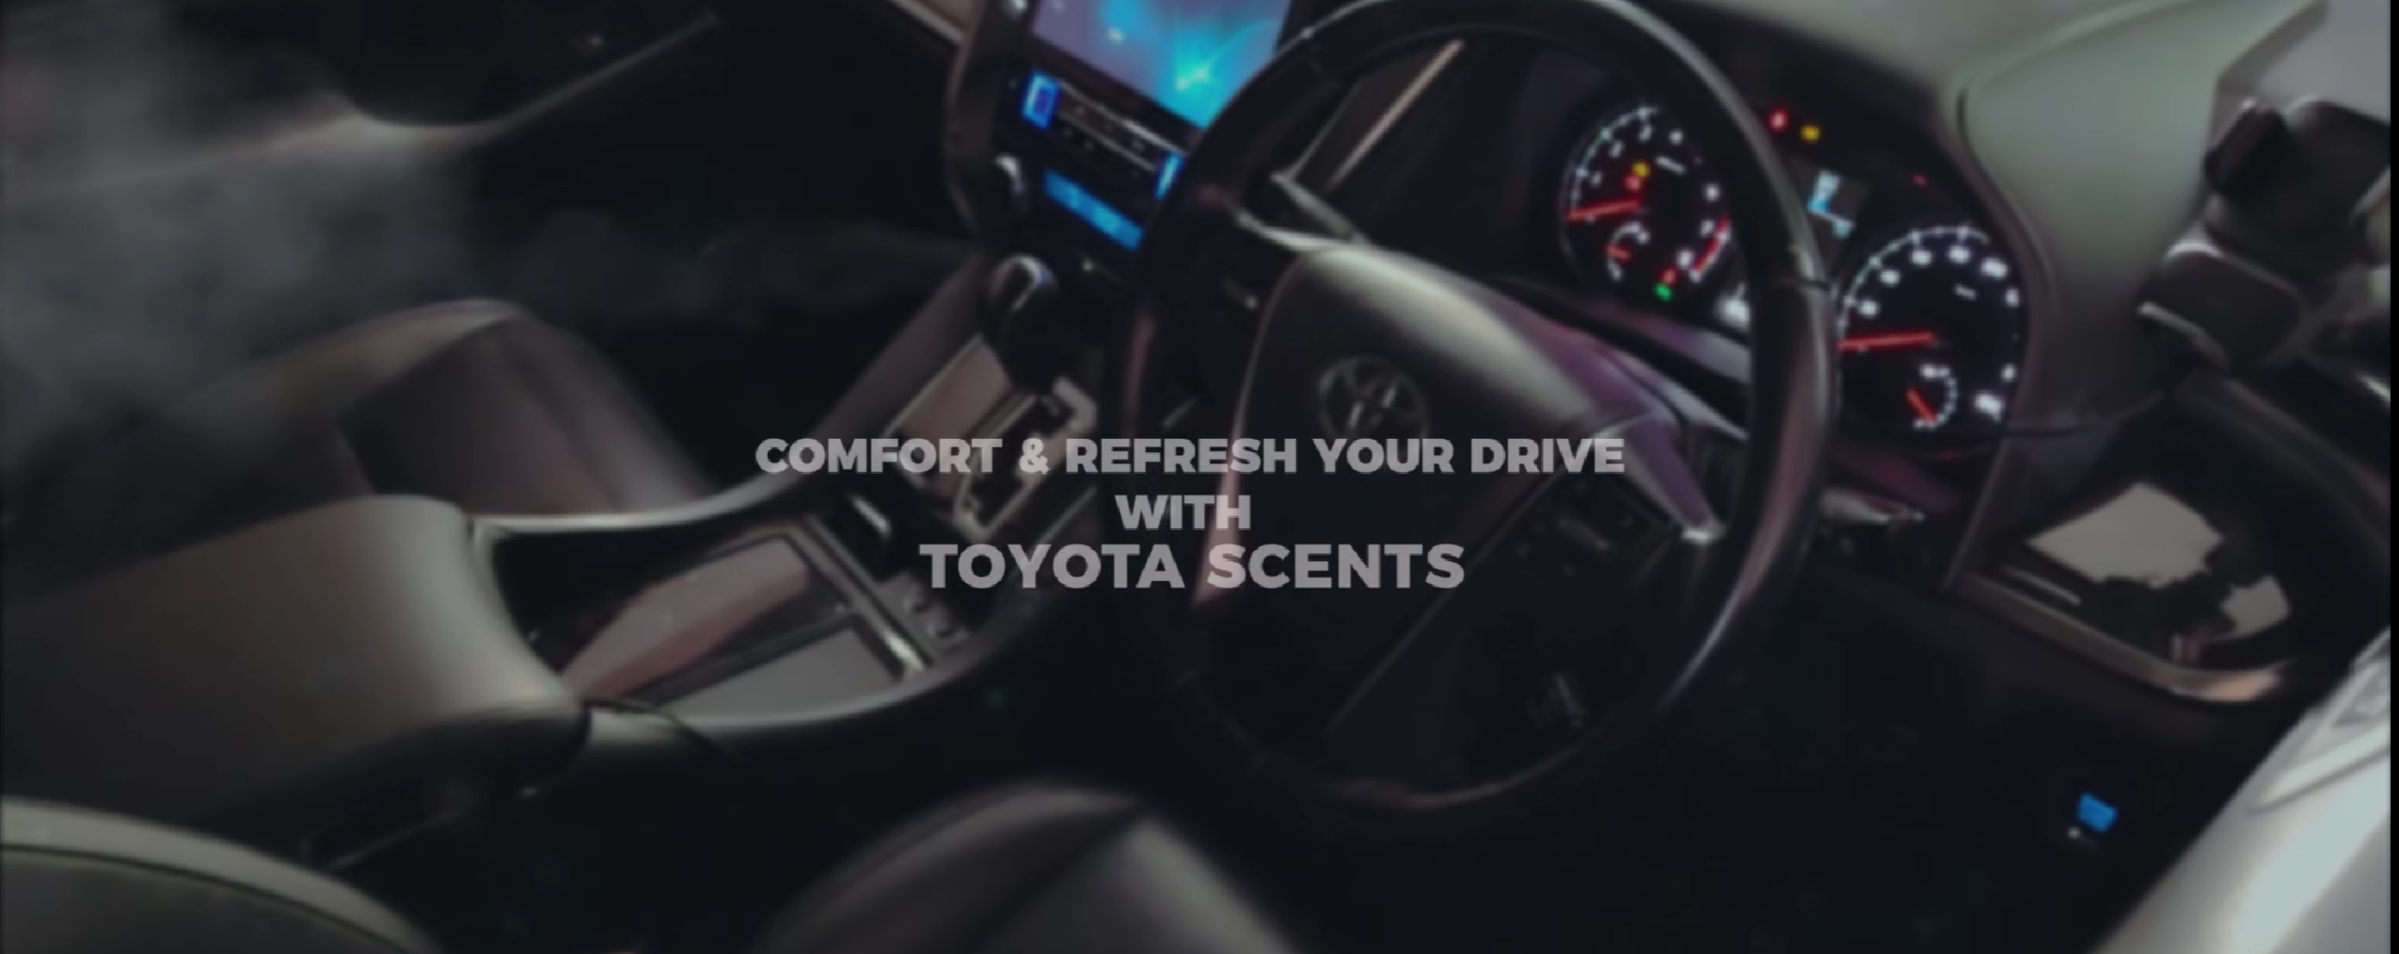

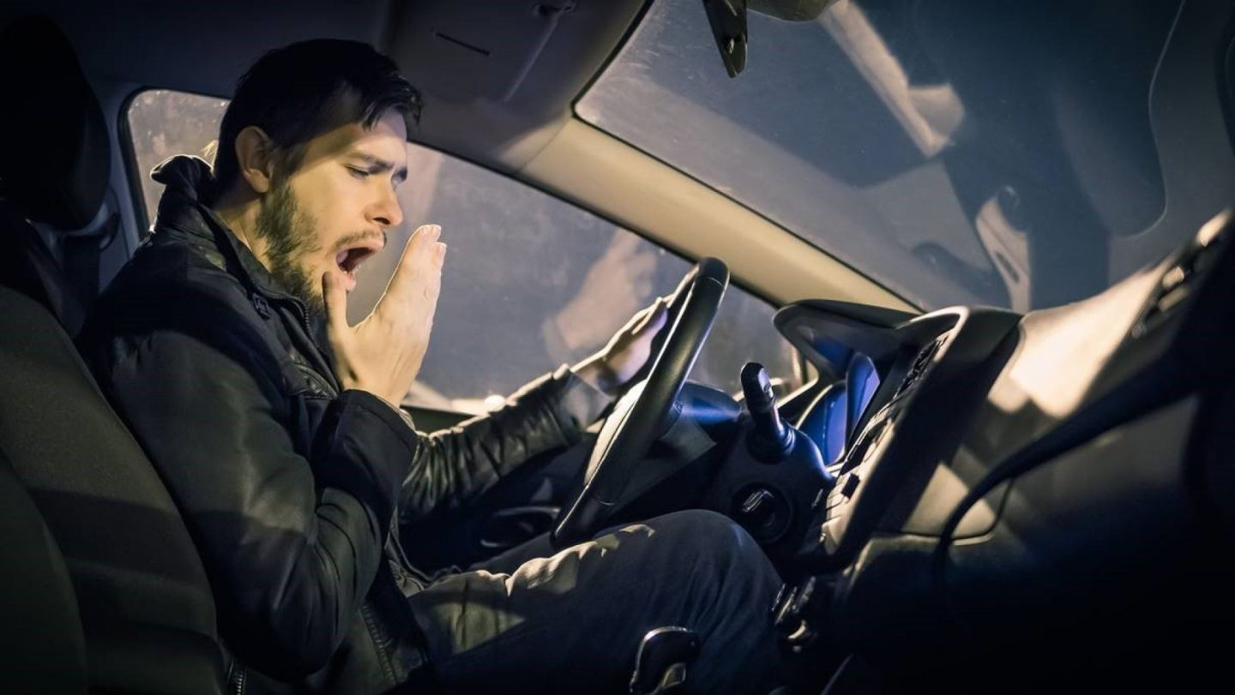
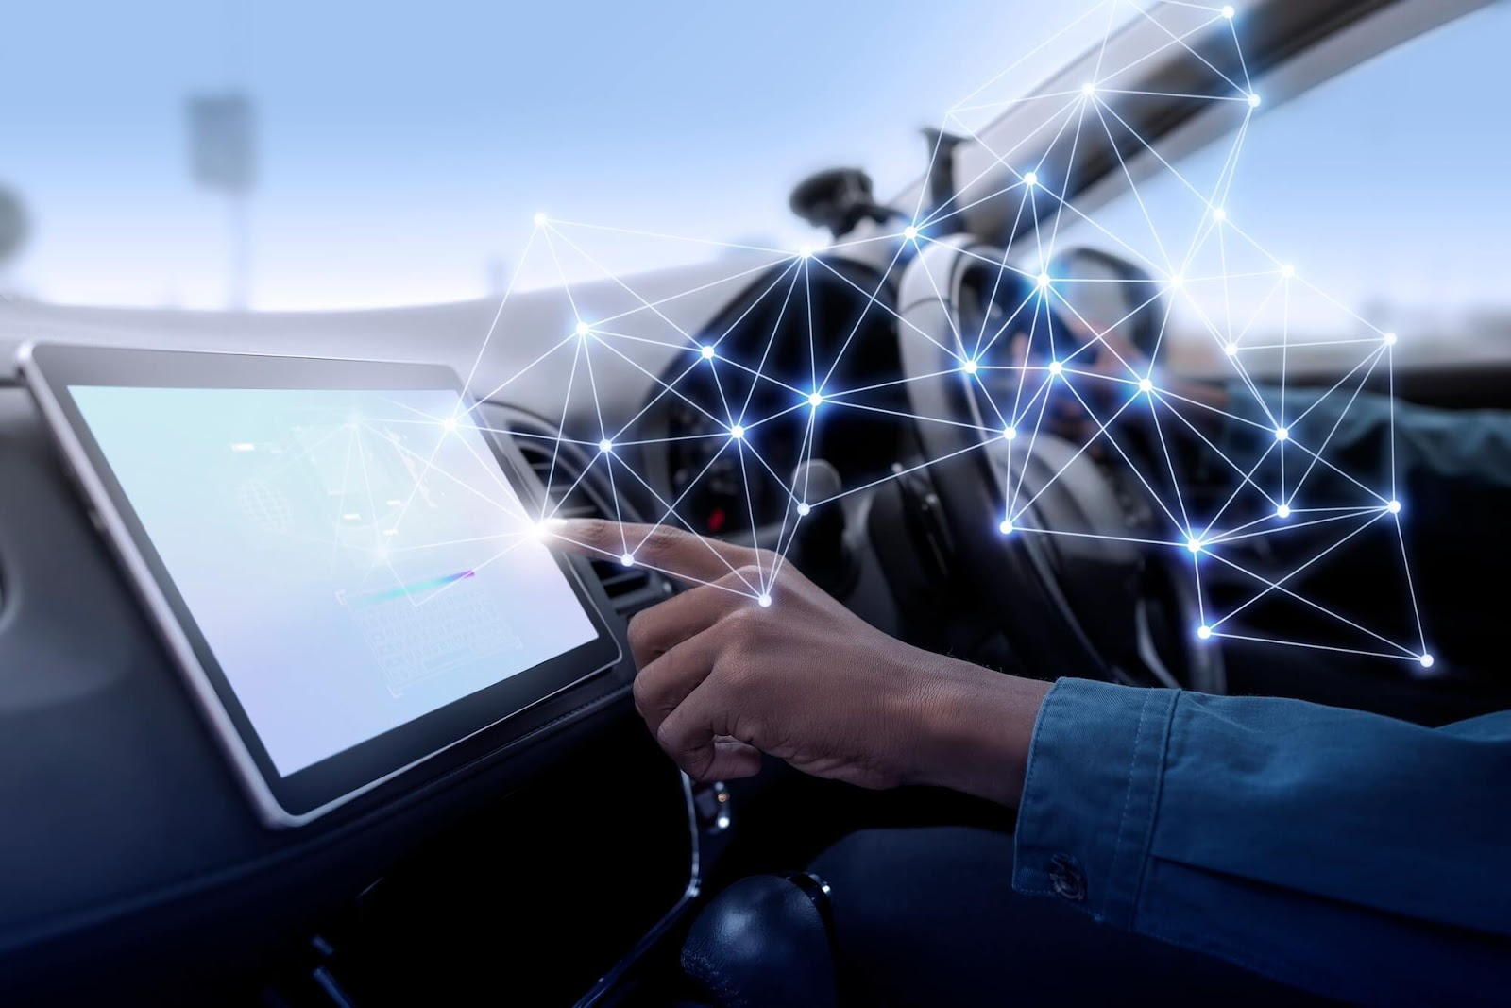

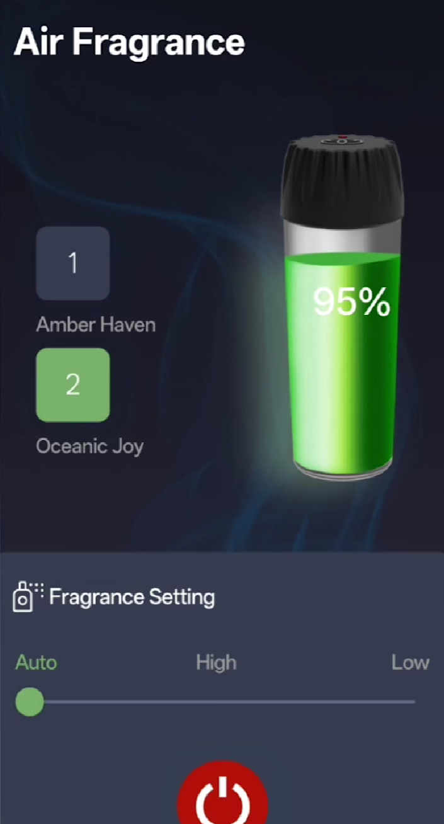
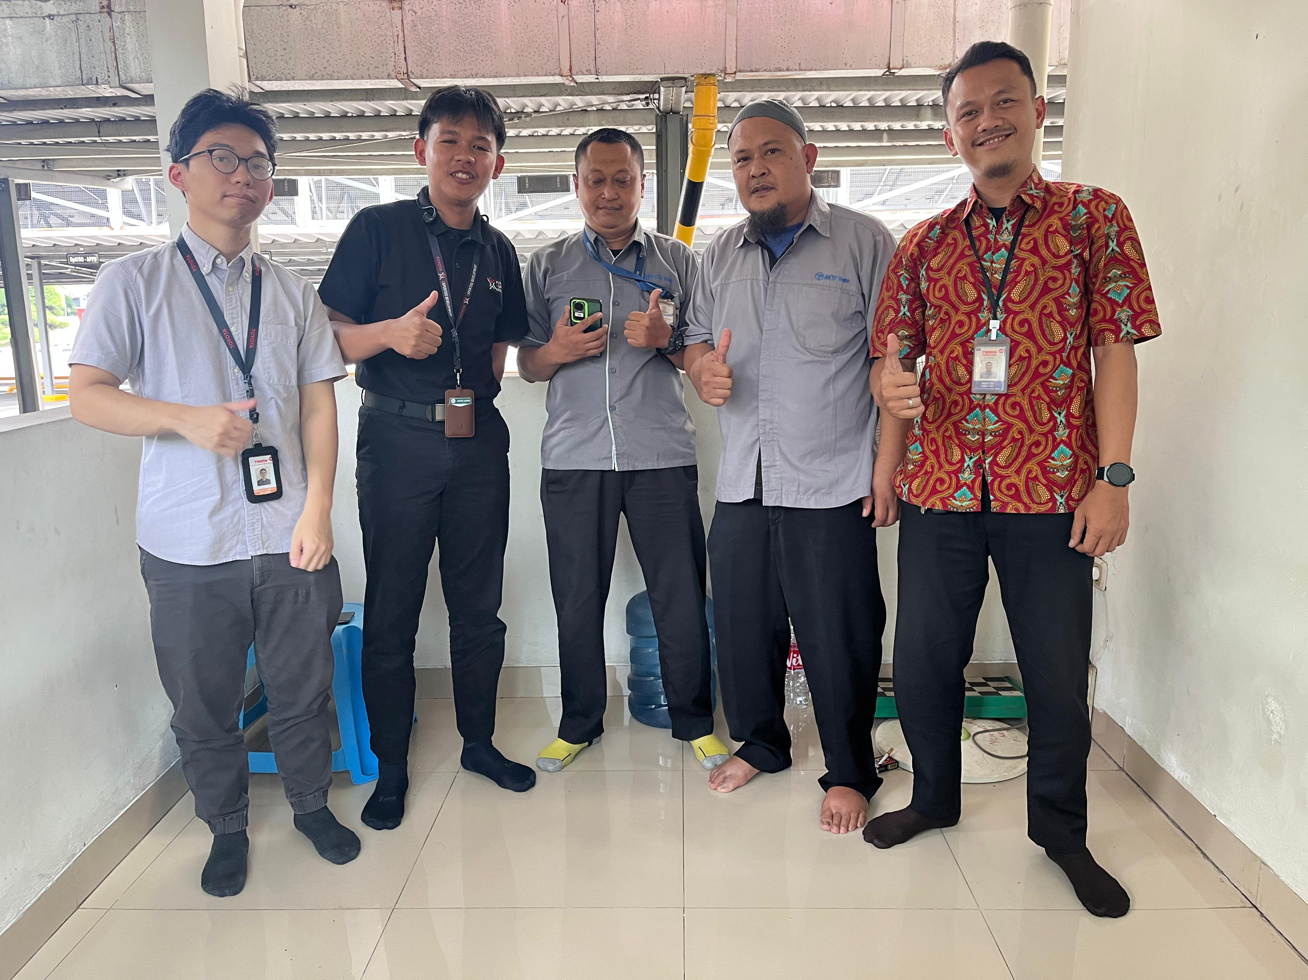
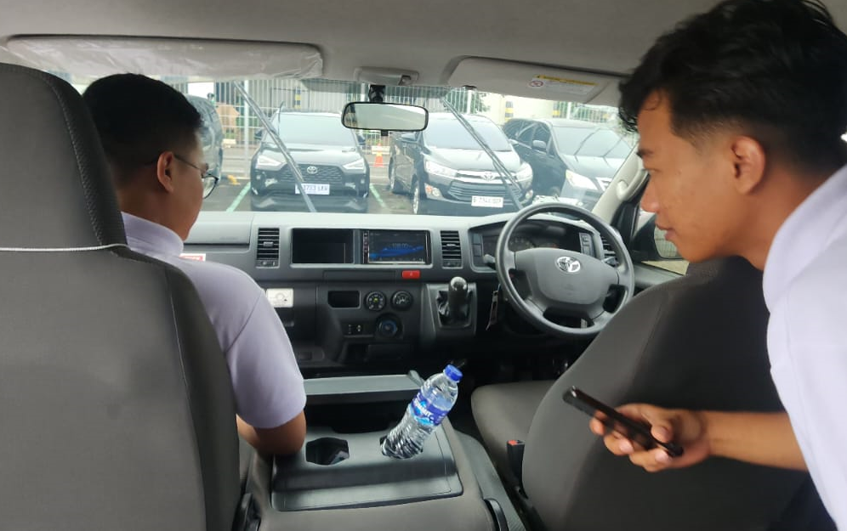
Background, workflow, Benchmark Competitor
Background
Workflow
Cabin scent is part of the “in-car experience” layer (comfort & premium feel), not only “air freshener”.
Fragrance can influence driver state and perceived cabin quality.
Benchmark from Toyota Smart Fragrance (TAM Product by TCO)
Impacts (what fragrance can affect)
Installed with integration to car’s electrical source.
Remote control & App
Comfort & well-being
Fatigue / alertness during driving
Personalization
Source: Ma, X. (2026). Effects of odor types and concentration adjustment modes of olfactory stimulation on fatigue in young https://doi.org/10.1016/j.trf.2026.103528
Mengutip dari Group C (Driver Monitoring System Project) observation
Driver GAD & Unit Observation
Note
Paragon
abisin waktu di rumah, kedua di mobil,
Tambahin background biar lebih banyak dan lebih kuat
Feedback :
The issue with the drowsiness detection in the Alphard is that it's overly sensitive and the buzzer is very loud, which disturbs the user while they are driving
Karawang Driver
Input:
If the buzzer can be eliminated, perhaps it could be replaced with actuator like an aroma dispenser or others
Hiace Commuter
Background
Idea Solution
Progress of Development
Item​ | Toyota Scents​ | Lepas L8​
Headunit Control​ | ✗​ | ✓​
Apps Control​ | ✓​ | ✓​
Ceramic Core ​ (No Free Liquid)​ | ✓​ | ✓​
Adjustable Intensity​ | ✓​ | ✓​
# of Cartridges​ | 2​ | 3​
Durability Cartridges​ | 3 Month​ | 3 Month​
Integration Type​ | Accessories ​(IDR 1.7 Million)​ | Factory-integrated​ OEM​

